Slide 1



ANT COLONY OPTIMIZATION
DONE BY BRIAN KELEIN NGWOH VISAS
ELECTRONICS ENGINEERING
SIXTH SEMESTER

Slide 2
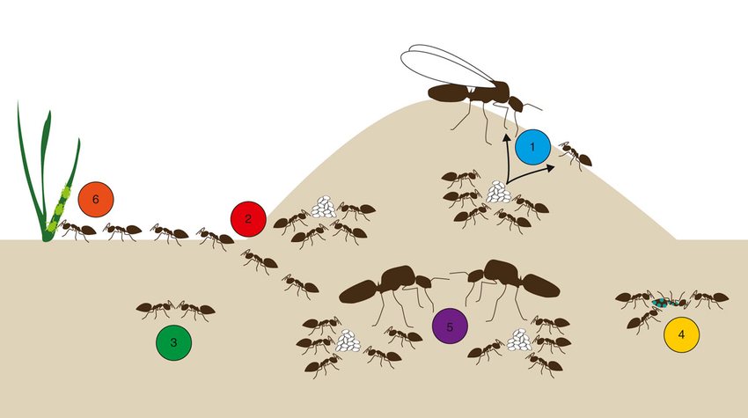
MOTIVATION

Slide 3
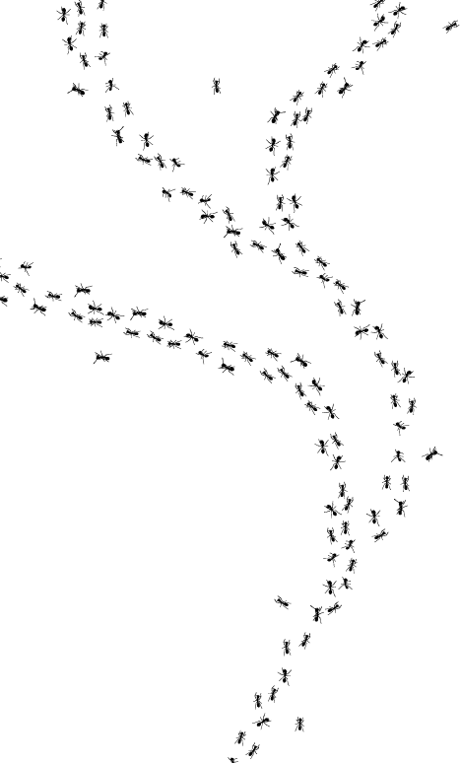
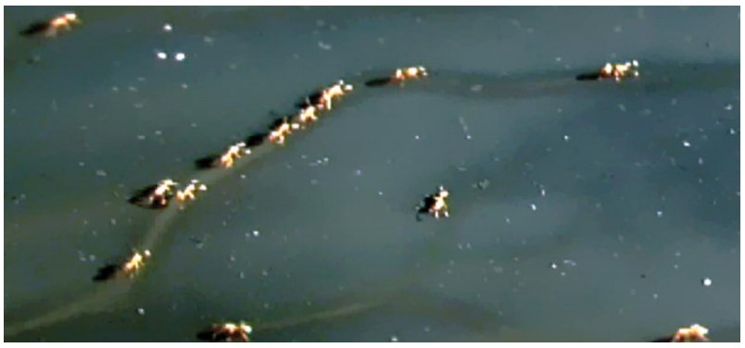
BIOLOGICAL BACKGROUND

Slide 4
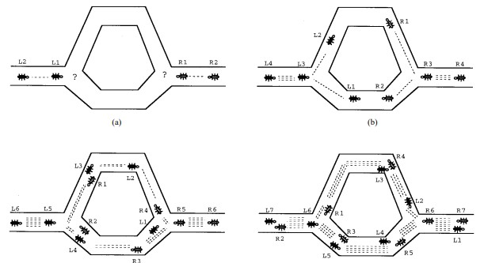
APPLICATION OF ANT COLONY OPTIMIZATION
Summary of the Travelling Sales Man Problem(TSP)

Slide 5
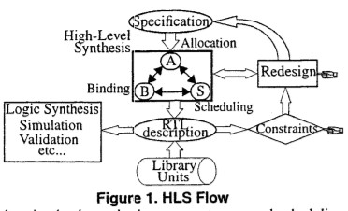
HIGH LEVEL SYNTHESIS
Main steps in High Level synthesis
Allocation
Scheduling
Binding

Slide 6
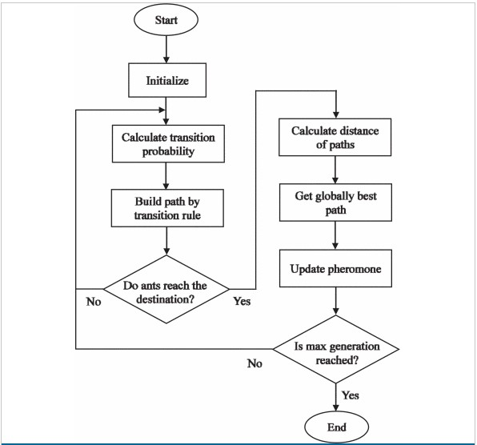
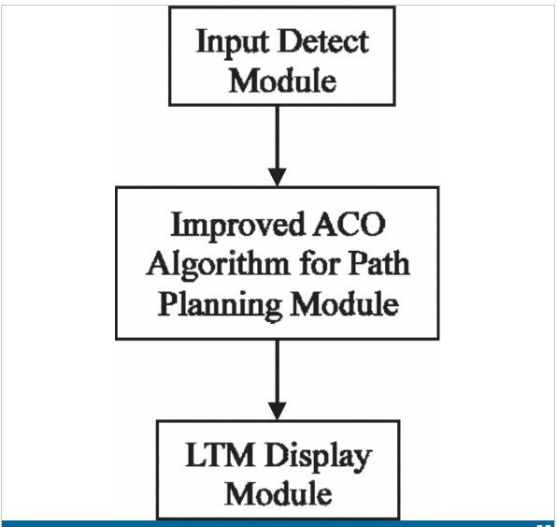
EXAMPLE APPLICATION : PATH PLANNING MODULE

Slide 7
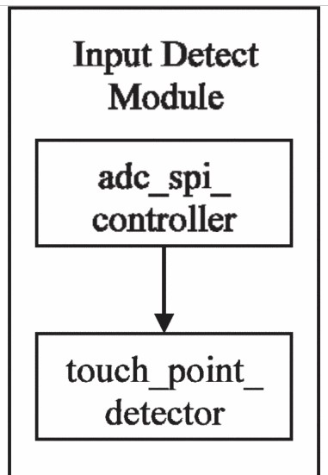
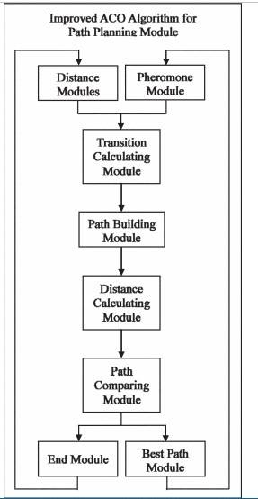
PATH PLANNING MODULE

Slide 8
CONCLUSION
Summary of Paper
Possibility of future improvement

Slide 9


Thanks for Listening
QUESTIONS

Slide 10
REFERENCES
ResearchGate. “Diagram of a Typical Ant Colony Representing the Six Topics...,” July 6, 2021. https://www.researchgate.net/figure/Diagram-of-a-typical-ant-colony-representing-the-six-topics-discussed-in-this-review-1_fig3_253337822. Accessed on the 07.07.2021.
“Follow the Trail,” PCT - Pest Control Technology. https://www.pctonline.com/article/follow-the-trail/ (accessed Jul. 07, 2021).
D. E. Jackson and F. L. W. Ratnieks, “Communication in ants,” Current Biology, vol. 16, no. 15, pp. R570–R574, Aug. 2006, doi: 10.1016/j.cub.2006.07.015. Accessed July 7, 2021
M. Dorigo and L. M. Gambardella, "Ant colony system: a cooperative learning approach to the traveling salesman problem," in IEEE Transactions on Evolutionary Computation, vol. 1, no. 1, pp. 53-66, April 1997, doi: 10.1109/4235.585892.
C. Hsu, W. Wang, Y. Chien, R. Hou and C. Tao, "FPGA implementation of improved ant colony optimization algorithm for path planning," 2016 IEEE Congress on Evolutionary Computation (CEC), 2016, pp. 4516-4521, doi: 10.1109/CEC.2016.7744364.

